Slide 1
Module 6

Slide 2
6.1INTERACTIVE DEBUGGING SYSTEMS
Debugging is a methodical process of finding and reducing the number of bugs, or defects, in a computer program
An interactive debugging system provides programmers with facilities that aid in the testing and debugging of programs.
A number of such systems are available, however the extent to which these tools are used varies widely.
The important requirements for an interactive debugging system and some basic considerations involved in providing these services is discussed here.

Slide 3
6.1.1 Debugging Functions And Capabilities
Execution sequencing: It is the observation and control of the flow of program execution. For example, the program may be halted after a fixed number of instructions are executed.
Breakpoints – The programmer may define break points which cause execution to be suspended, when a specified point in the program is reached. After execution is suspended, the debugging command is used to analyze the progress of the program and to diagnose errors detected. Execution of the program can then be resumed.
Conditional Expressions – Programmers can define some conditional expressions, that are continually evaluated during the debugging session. Program execution is suspended, when conditions are met, analysis is made, later execution is resumed

Slide 4
Gaits- Given a good graphical representation of program progress may even be useful in running the program in various speeds called gaits.
Tracing - can be used to track the flow of execution logic and data modifications. The control flow can be traced at different levels of detail – procedure, branch, individual instruction, and so on.
Trace back can show the path by which the current statement in the program was reached. It can also show which statements have modified a given variable or parameter. The statement numbers are displayed rather than as hexadecimal displacements.

Slide 5
Program-display Capabilities - It is also important for a debugging system to have good program display capabilities.
It must be possible to display the program being debugged, completely with statement numbers. The user should be able to control the level at which this display occurs. For eg: The program may be displayed as originally written or with macro expansion.
It is useful to modify and incrementally recompile the program during the debugging session. The system should save all the debugging specifications across such a recompilation so the programmer does not reissue all of these debugging commands.
It should be possible to symbolically display or modify the contents of any of the variables and constants in the program and then resume execution – after these changes.

Slide 6
Multilingual Capability - A debugging system should consider the language in which the program being debugged is written.
Most user environments and many applications systems involve the use of different programming languages. A single debugging tool should be available to multilingual situations.
Debugger commands that initiate actions and collect data about a program’s execution should be common across languages.
A debugging system must be sensitive to the specific language being debugged so that procedural, arithmetic and conditional logic can be coded in the syntax of that language.
When the debugger receives control, the execution of the program being debugged is temporarily suspended.
The debugger must then be able to determine the language in which the program is written and set its context accordingly.
The debugger should be able to switch its context when a program written in one language calls a program written in a different language.

Slide 7
Context Effects
The context being used has many different effects on the debugging interaction.
For example. The statements are different depending on the language
COBOL - MOVE 6.5 TO X
FORTRAN - X = 6.5
Likewise conditional statements should use the notation of the source language
COBOL - IF A NOT EQUAL TO B
FORTRAN - IF (A .NE. B)
Similar differences exist with respect to the form of statement labels, keywords and so on.

Slide 8
Certain debugging functions varies according to the language of the program being debugged.
These functions are accomplished in the same manner in different programming languages.
To perform these operations, the debugger must get the information gathered by the language translator.
But the gather information format varies widely between different language translators.
The compilers and assemblers (language translators) aim to provide a consistent interface with the debugging system.
For this the Information for the debugger is provided in a standard format regardless of the internal form used in the translator.
The translator provide debugger interface modules that can respond to requests for information in a standard way regardless of the language being debugged.

Slide 9
Display of source code
The language translator may provide the source code or source listing tagged in some standard way so that the debugger has a uniform method of navigating about it.
Optimization:
It is also important that a debugging system be able to deal with optimized code.
Many optimizations involve the rearrangement of segments of code in the program For eg. - invariant expressions can be removed from loop – separate loops can be combined into a single loop - redundant expression may be eliminated - elimination of unnecessary branch instructions.
All these types of optimization creates problems for the debugger.
The user of a debugging system deals with the source program in its original form before optimizations are performed.

Slide 10
The code rearrangement alters the execution sequence and may affect tracing, break points and even statement counts if entire statements are involved. If an error occurs, it may be difficult to relate the error to the appropriate location in the original source program.
The debugging of optimized code requires a substantial amount of cooperation from the optimizing compiler.
The compiler must retain information about any transformations that it performs on the program. Such information can be made available both to the debugger and to the programmer. Where reasonable, the debugger should use this information to modify the debugging request made by the user, and thereby perform the intended operation.

Slide 11
6.1.2 Relationship with Other Parts of the System
An interactive debugger must be related to other parts of the system in many different ways.
The important requirement for an interactive debugger is that it always be available.
Interactive debugger must appear to be a part of the run-time environment and an integral part of the system.
When an error is discovered, immediate debugging must be possible because it may be difficult or impossible to reproduce the program failure in some other environment or at some other times.
For example user need to be able to debug in a production environment. When an application fails during a production run, work dependent on that application stops. Since the production environment is often quite different from the test environment, many program failures cannot be repeated outside the production environment.

Slide 12
Debugger must also exist in a way that is consistent with the security and integrity components of the system. Use of debugger must be subjected to the normal authorization mechanism and must leave the usual audit trails. Someone (unauthorized user) must not access any data or code.
It must not be possible to use the debuggers to interface with any aspect of system integrity.
The debugger must coordinate its activities with those of existing and future language compilers and interpreters.
It is assumed that debugging facilities in existing language will continue to exist and be maintained.
The requirement for a cross-language debugger assumes that such a facility would be installed as an alternative to the individual language debuggers.

Slide 13
6.1.3 User-interface Criteria
The interactive debugging system should be user friendly.
The facilities of debugging system should be organized into few basic categories of functions which should closely reflect common user tasks.
Debugging systems should be simple in its organization and familiar in its language. This simple organization contributes greatly to ease of training and ease of use.
Full – screen displays and windowing systems
The user interaction should make use of full-screen displays and windowing systems.
The advantage of such interface is that the information can be should displayed and changed easily and quickly.

Slide 14
Menus:
With menus and full screen editors, the user has far less information to enter and remember
It should be possible to go directly to the menus without having to retrace an entire hierarchy.
When a full-screen terminal device is not available, user should have an equivalent action in a linear debugging language by providing commands.

Slide 15
Command language:
The command language should have a clear, logical, simple syntax.
Parameters names should be consistent across set of commands
Parameters should automatically be checked for errors for type and range values.
Defaults should be provided for parameters.
Command language should minimize punctuations such as parenthesis, slashes, and special characters.
On Line HELP facility
Good interactive system should have an on-line HELP facility that should provide help for all options of menu
Help should be available from any state of the debugging system.

Slide 16
Methods Of Debugging
Debugging by Brute Force Attack.
Debugging by Induction
Debugging by Deduction
Debugging by Backtracking
Debugging by Testing

Slide 17
DEBUGGING BY INDUCTION
Careful thoughts will find most errors without the debugger even going near the computer.
One particular thought process is induction, where you move from the particulars of a situation to the whole.
Start with the clues (the symptoms of the error, possibly the results of one or more test cases) and look for relationships among the clues.

Slide 18
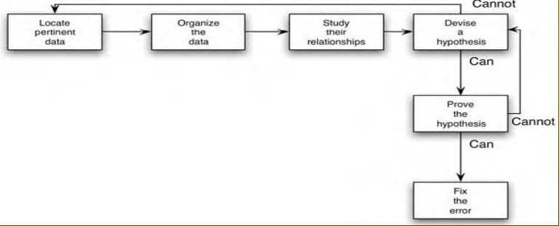
DEBUGGING BY INDUCTION

Slide 19
DEBUGGING BY INDUCTION - STEPS
Locate the pertinent data :enumeration of all you know about what the program did correctly and what it did incorrectly
Organize the data : structure the pertinent data to let you observe the patterns.
Devise a hypothesis : study the relationships among the clues and devise, using the patterns that might be visible in the structure of the clues, one or more hypotheses about the cause of the error.
Prove the hypothesis : prove the reasonableness of the hypothesis before you proceed. If you skip this step, you’ll probably succeed in correcting only the problem symptom, not the problem itself.
Fix the Error: If hypothesis is proved successfully then go on to fix the error else repeat steps 3 and 4

Slide 20
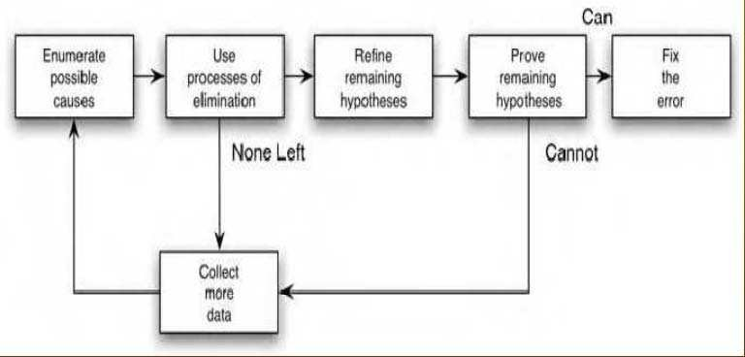
DEBUGGING BY DEDUCTION
The process of deduction proceeds from some general theories or premises, using the processes of elimination and refinement, to arrive at a conclusion (the location of the error).

Slide 21
DEBUGGING BY DEDUCTION - STEPS
Enumerate the possible causes or hypotheses. The first step is to develop a list of all conceivable causes of the error.
Use the data to eliminate possible causes. Carefully examine all of the data, particularly by looking for contradictions, and try to eliminate all but one of the possible causes. If all are eliminated, you need more data through additional test cases to devise new theories.
Refine the remaining hypothesis. The possible cause at this point might be correct, but it is unlikely to be specific enough to pinpoint the error. Hence, the next step is to use the available clues to refine the theory.
Prove the remaining hypothesis. identical to step 4 in the induction method.

Slide 22
DEBUGGING BY BACKTRACKING
An effective method for locating errors in small programs is to backtrack the incorrect results through the logic of the program until you find the point where the logic went astray.
Start at the point where the program gives the incorrect result—such as where incorrect data were printed.
Mental reverse execution of the program from this point and repeatedly using the process of “if this was the state of the program at this point, then this must have been the state of the program up here,” you can quickly pinpoint the error

Slide 23
Device drivers
1. General design of a device driver
A device driver is the glue between an operating system and its I/O devices.
Device drivers act as translators, converting the generic requests received from the OS into commands that specific peripheral controllers can understand.
In the figure, the application software makes system calls to the OS requesting services.
The OS analyzes these requests and, when necessary, issues requests to the appropriate device driver.
The device driver in turn analyses the request from the OS and, when necessary, issues commands to the hardware interface to perform the operations needed to service the request.

Slide 24
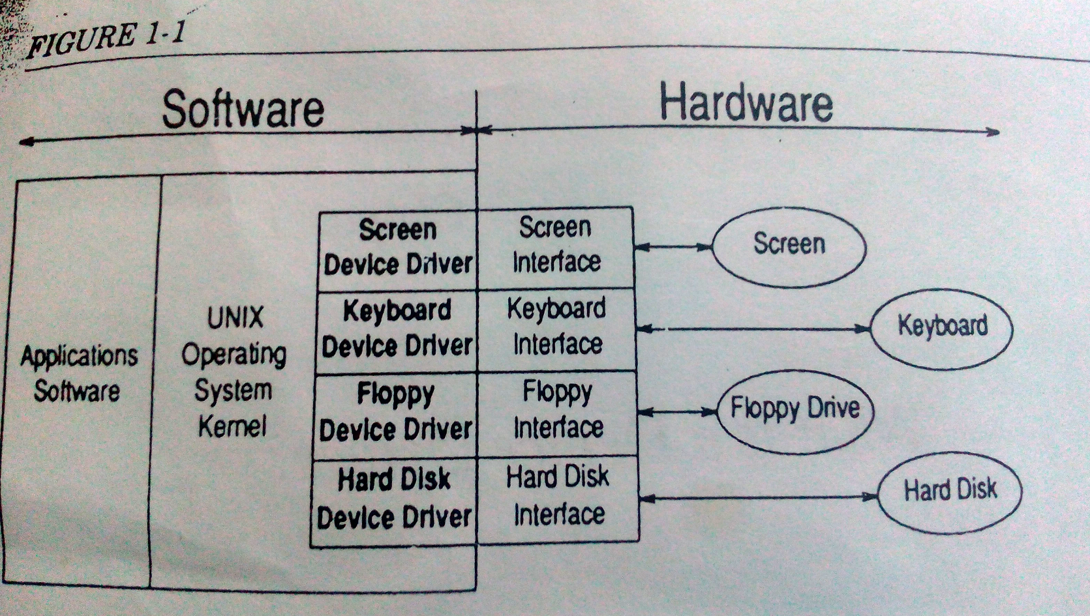

Slide 25
The existence of device drivers simplifies the OS considerably.
Without device drivers, the OS would be responsible for talking directly to the hardware. This would require the OS’s designer to include support for all of the devices that users might want to connect to their computer. Adding support for a new device requires the modification of OS itself.
By separating device driver’s functions from the OS, the designer of OS deals with the issues that relate to the operation of the system as a whole. Details related to individual hardware devices can be ignored and generic requests for I/O operations can be issued by the OS to the device driver.

Slide 26
The device driver take detailed device – independent requests from the OS and manipulate the hardware in order to fulfill the request.
The OS can be written without any knowledge of the specific devices that will be connected.
The device drivers can connect any I/O device to the system without having to modify the OS.
The device drivers for new devices can be added without changing the OS.
Device drivers provide the OS with a standard interface to non – standard I/O devices.

Slide 27
Major design issues
Operating system/ driver communications
Driver/ hardware communications
Driver operations
Operating system/ driver communications – covers all the issues related to the exchange of information(commands and data) between the device driver and the OS. It also includes support functions that the kernel provides for the benefit of the device driver.
Driver/ hardware communications – covers those issues related to the exchange of information(commands and data) between the device driver and the device it controls( i. e. the hardware). This also includes issues such as how software talks to hardware and how the hardware talks back.

Slide 28
3. Driver operations – covers issues related to the actual internal operation of the driver itself. This includes:
Interpreting commands received from the OS.
Scheduling multiple outstanding requests for service.
Managing the transfer of data across both interfaces( OS and hardware)
Accepting and processing hardware interrupts
Maintaining the integrity of the driver’s and the kernel’s data structures.

Slide 29
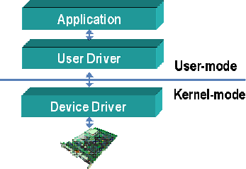
GENERAL DESIGN OF A DEVICE DRIVER

Slide 30
Block device drivers
Block device drivers communicate with the OS through a collection of fixed sized buffers.
The OS manages a cache of these buffers and attempts to satisfy user requests for data by accessing buffers in the cache.
The driver is invoked only when the requested data is not in the cache, or when buffers in the cache have been changed and must be written out.
Because of this buffer cache the driver is insulated from many of the details of the users requests and need only handle requests from the OS to fill or empty fixed – sized buffers.
Block drivers are used primarily to support devices that can contain file systems(such as hard disks).

Slide 31
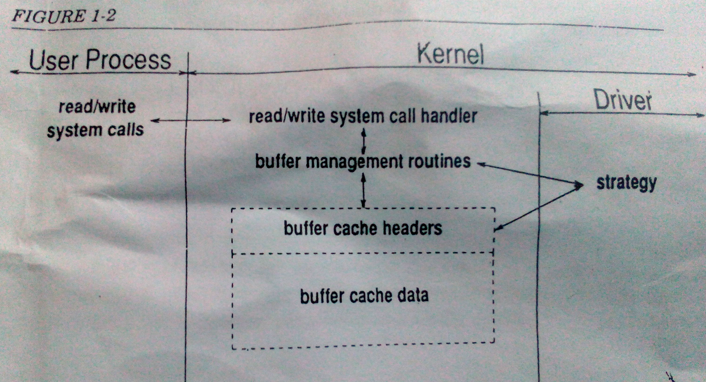

Slide 32
Character device drivers
Character drivers can handle I/O requests of arbitrary size and can be used to support almost any type of device.
Character drivers are used for devices that either deal with data a byte at a time (such as line printers)
OR
Work best with data in chunks smaller or larger than the standard fixed sized buffers used by block drivers.
One of the major differences between block and character drivers is that while user processes interact with block drivers only indirectly through the buffer cache, their relationship with character drivers is very direct.
The I/O request is passed unchanged to the driver to process and the character driver is responsible for transferring the data directly to and from the user process’s memory.

Slide 33
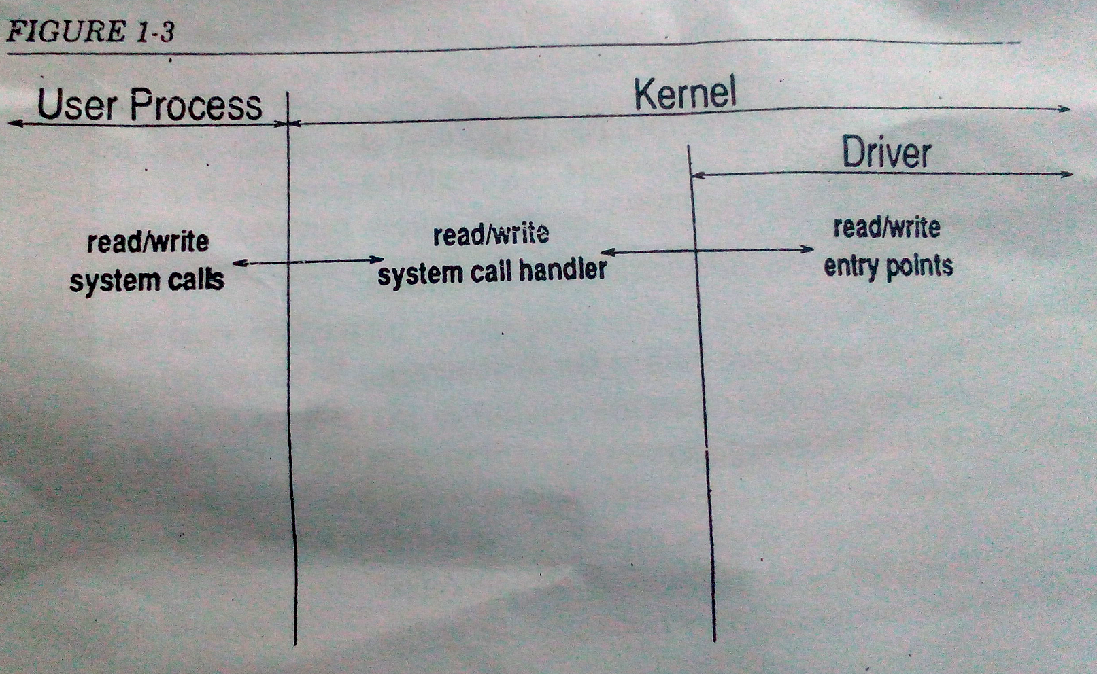

Slide 34
Character Device Vs. Block Device
A Character ('c') Device is one with which the Driver communicates by sending and receiving single characters (bytes, octets).
A Block ('b') Device is one with which the Driver communicates by sending entire blocks of data.
Examples for Character Devices: serial ports, parallel ports, sounds cards.
Examples for Block Devices: hard disks, USB cameras, Disk-On-Key.

Slide 35
Anatomy of a device driver
A device driver is a set of entry points(routines) that can be called by the OS.
A driver also contain : data structures private to the driver, references to kernel data structures external to the driver and routines private to the driver.
Most device drivers are written as a single source file.
The initial part of the driver is called prologue.

Slide 36
The prologue is everything before the first routine and like most C programs contains:
# include directives referencing header files which define various kernel data types and structures.
# define directives that provide mnemonic names for various constants used in the driver.
Declarations of variables and data structures
The remaining part of the driver are the entry points( C functions referenced by the OS) and routines (C functions private to the driver)

Slide 37
Writing device drivers is somewhat different from writing application program in C.
The main difference is that device drivers are part of the kernel and not normal user processes. This means that many of the things a normal C program can do a driver cannot.
The functions that are supported by our kernel may be found in the device driver manual for our system.
The stack space available is limited and is not expandable.
Do not use recursive functions and do not declare local arrays.
Do not use floating point arithmetic. Although the machine may have a floating point unit, the kernel does not save the contents of the FPU registers unless it is planning to switch processes. Therefore using FPU can cause incorrect results both in the code and some user’s programs and at worst can cause the system to crash.

Slide 38
Do not busy wait(spin) within the deriver waiting for an event to occur unless the expected time to wait is less than the time to leave the device driver and re-enter it when an interrupt occurs.
A spin loop will prevent the system from doing anything but responding to interrupts.

